Slide 1

Geometry
Unit 11, Lesson 8 Triangle Midsegment Theorem Volume 2, pg. 220

Slide 2


Benchmarks
MA.912.GR.1.3
Prove relationships and theorems about triangles. Solve mathematical and real-world problems involving postulates, relationships, and theorems of triangles.
MA.912.LT.4.10
Judge the validity of arguments and give counterexamples to disprove statements.
volume 2, pg. 220

Slide 3
Integrated Mathematical Thinking and Reasoning Standards
MA.K12.MTR.1.1 Actively participate in effortful learning both individually and collectively.
MA.K12.MTR.4.1 Engage in discussions that reflect on the mathematical thinking of self and others.
MA.K12.MTR.5.1 Use patterns and structure to help understand and connect mathematical concepts.
MA.K12.MTR.6.1 Assess the reasonableness of solutions.
volume 2, pg. 220

Slide 4

Learning Targets
I can discover the triangle midsegment theorem using AA similarity.
I can use the triangle midsegment theorem to prove relationships and to solve problems.
volume 2, pg. 220

Slide 5

Warm-Up
volume 2, pg. 220

Slide 6
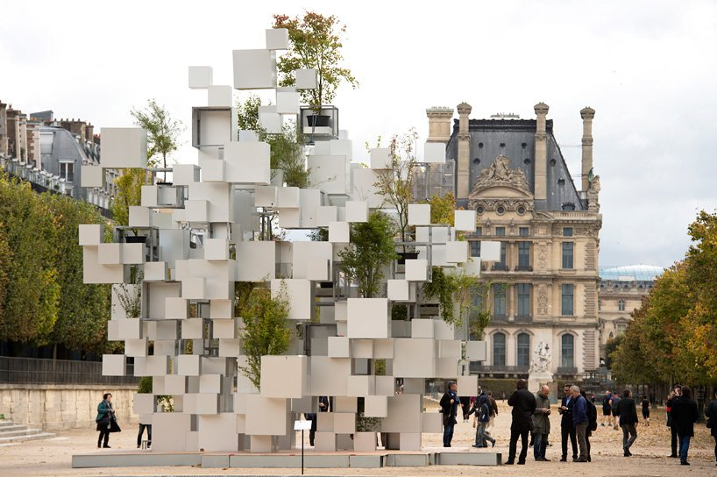
11.8.1 Warm-Up: “Many Small Cubes”
Japanese architect Sou Fujimoto exhibited a sculpture of stacked and suspended aluminum cubes as a part of the art fair in the Parisian Jardins des Tuileries’ gardens.
volume 2, pg. 220

Slide 7
What do you notice about the structure?
What do you wonder?
volume 2, pg. 220

Slide 8

Exploration
volume 2, pg. 221

Slide 9

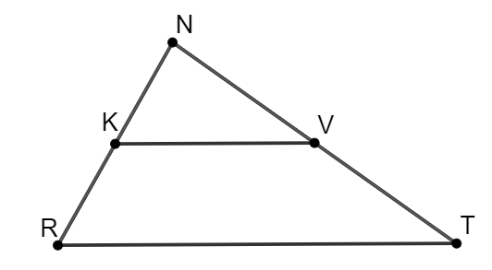

11.8.2 Exploration: Triangle Midsegment
$∆NKV$ and $∆NRT$ are shown, where $\overline{KV}∥\overline{RT}$.
Discuss with your partner what can be concluded from the given information. Justify your conclusions.
volume 2, pg. 221

Slide 10
Ask a classmate for two conclusions they made. Record their conclusions and write your summary of their reason. You are the only person who should write in the first two columns of the table. Have the person initial next to your summary stating that your summary was correct.
Conclusion | My Summary of Their Reason | Initials
volume 2, pg. 221

Slide 11
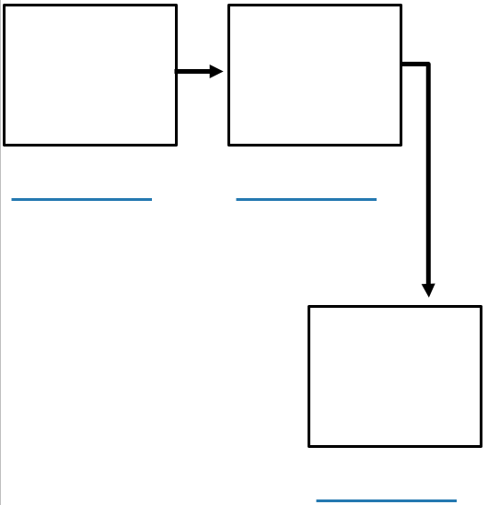
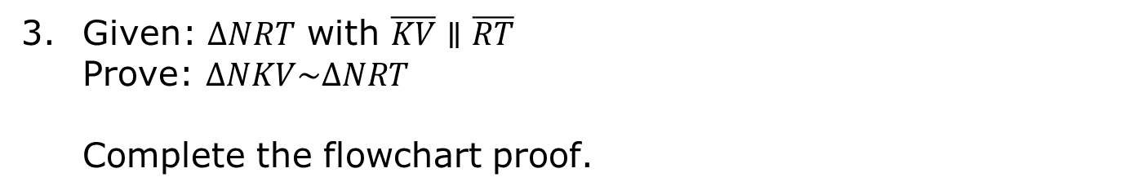
Given: $∆NRT$ with $\overline{KV}∥\overline{RT}$
Prove: $∆NKV\sim ∆NRT$
Complete the flowchart proof.
volume 2, pg. 221

Slide 12
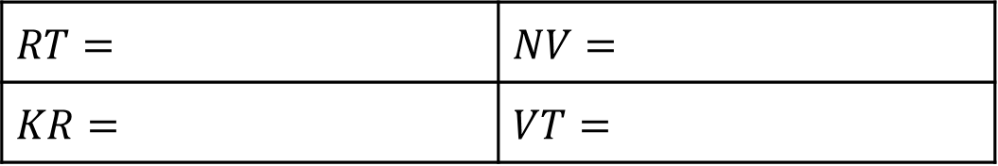
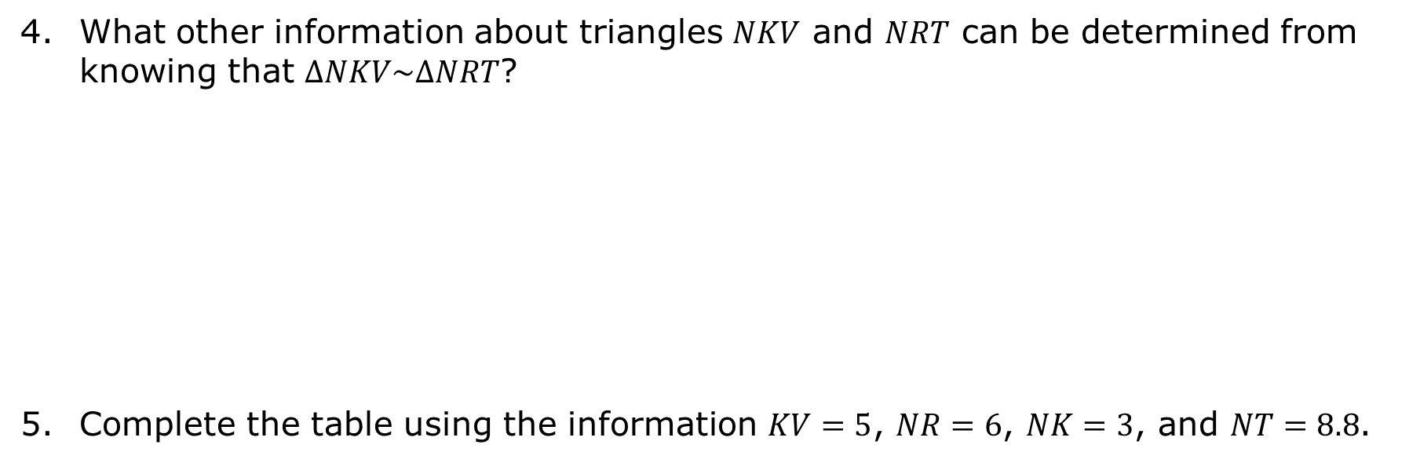
What other information about triangles $NKV$ and $NRT$ can be determined from knowing that $∆NKV\sim ∆NRT$?
Complete the table using the information $KV=5$, $NR=6$, $NK=3$, and $NT=8.8$.
$$RT=$$ | $$NV=$$
$$KR=$$ | $$VT=$$
volume 2, pg. 222

Slide 13

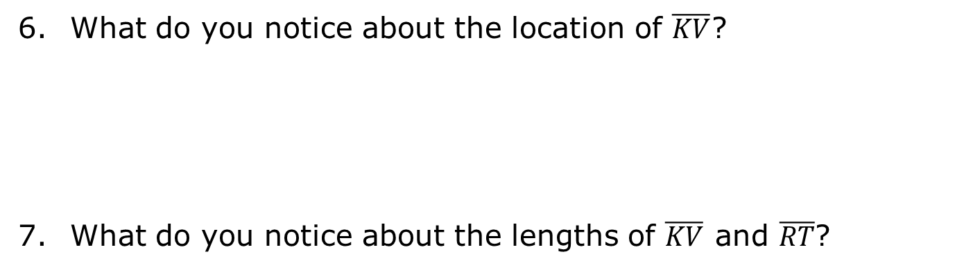
What do you notice about the location of $\overline{KV}$?
What do you notice about the lengths of $\overline{KV}$ and $\overline{RT}$?
Triangle Midsegment Theorem
The midsegment of a triangle joins the midpoints of two sides of a triangle such that its length is half the length of the third side of the triangle, and it is parallel to the third side of the triangle.
volume 2, pg. 222

Slide 14

Guided Practice
volume 2, pg. 222

Slide 15

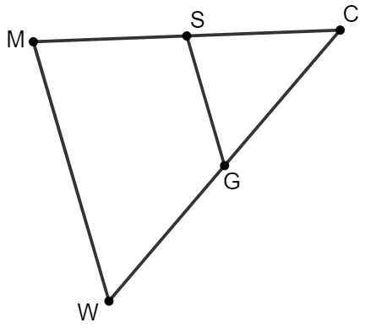
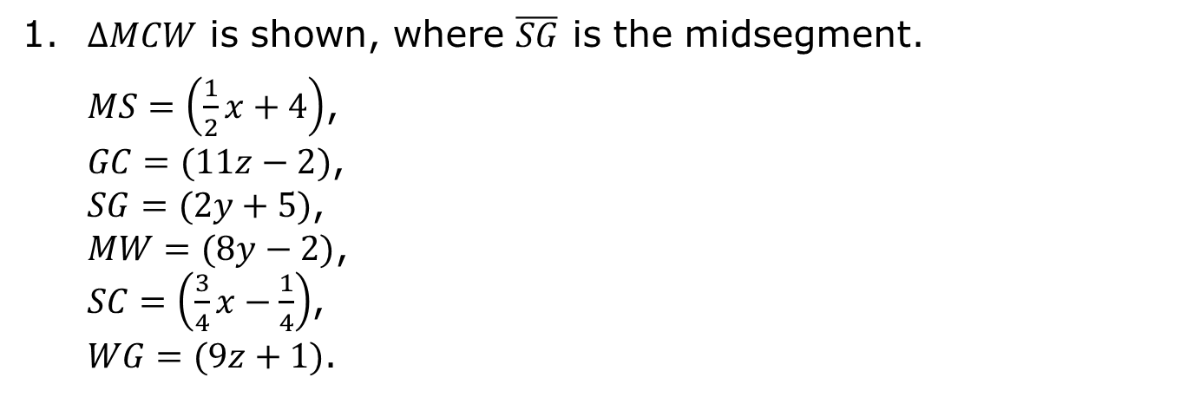
11.8.3 Guided Practice: Triangle Midsegment Theorem
1. $∆MCW$ is shown, where $\overline{SG}$ is the midsegment.
$MS=\left(\frac{1}{2}x+4\right)$,
$GC=(11z−2)$,
$SG=(2y+5)$,
$MW=(8y−2)$,
$SC=\left(\frac{3}{4}x−\frac{1}{4}\right)$,
$WG=(9z+1)$.
volume 2, pg. 222

Slide 16

Find the value of $x$.
Find the value of $y$.
Find the value of $z$.
What is the perimeter of $∆MCW$?
volume 2, pg. 222

Slide 17
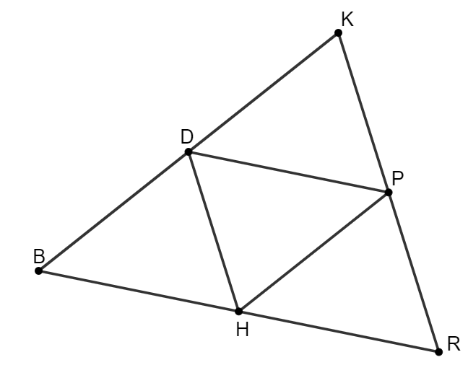
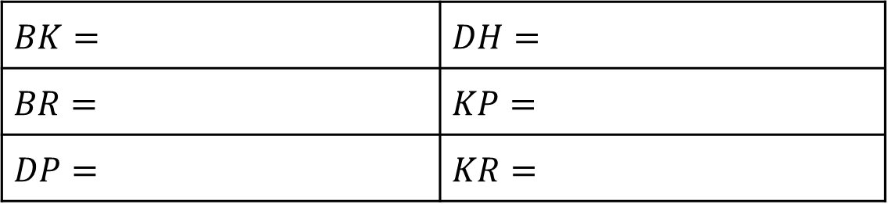
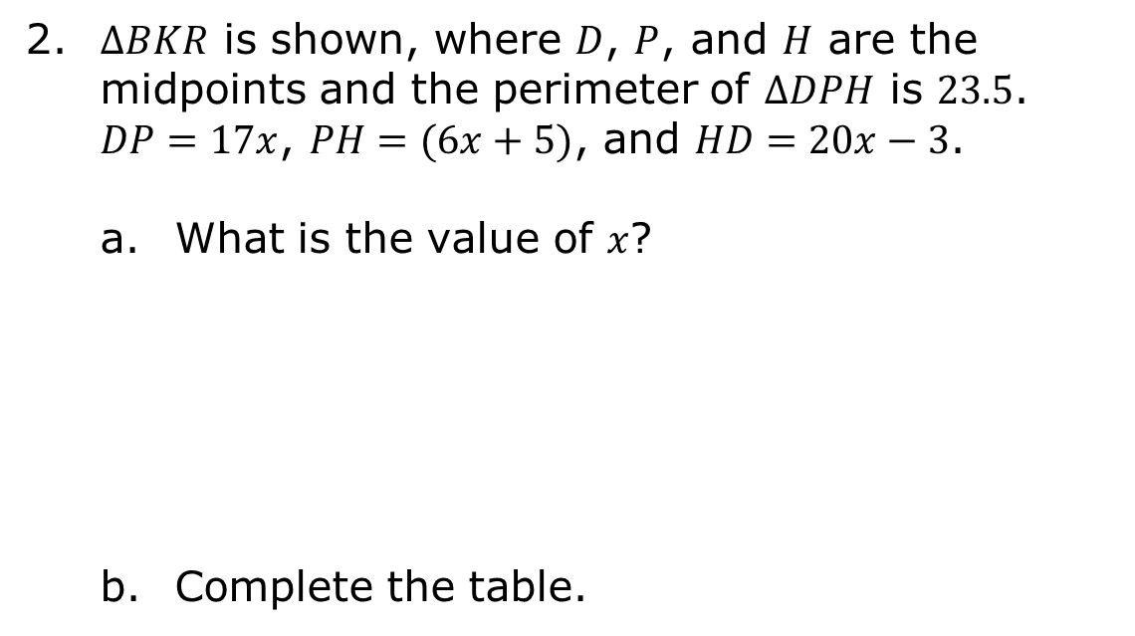
2. $∆BKR$ is shown, where $D$, $P$, and $H$ are the midpoints and the perimeter of $∆DPH$ is $23.5$. $DP=17x$, $PH=(6x+5)$, and $HD=20x−3$.
What is the value of $x$?
Complete the table.
$$BK=$$ | $$DH=$$
$$BR=$$ | $$KP=$$
$$DP=$$ | $$KR=$$
volume 2, pg. 223

Slide 18
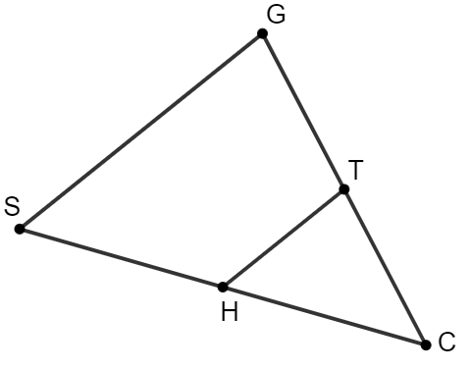
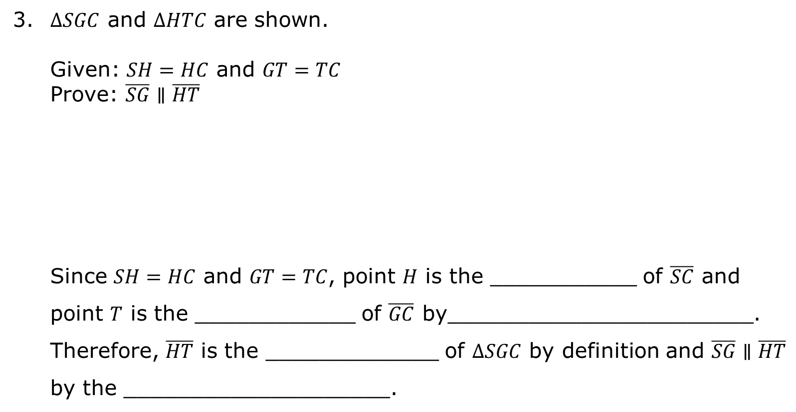
3. $∆SGC$ and $∆HTC$ are shown.
Given: $SH=HC$ and $GT=TC$
Prove: $\overline{SG}∥\overline{HT}$
Since $SH=HC$ and $GT=TC$, point $H$ is the ___________ of $\overline{SC}$ and point $T$ is the ____________ of $\overline{GC}$ by_______________________. Therefore, $\overline{HT}$ is the _____________ of $∆SGC$ by definition and $\overline{SG}∥\overline{HT}$ by the ____________________.
volume 2, pg. 223

Slide 19

Your Turn
volume 2, pg. 224

Slide 20
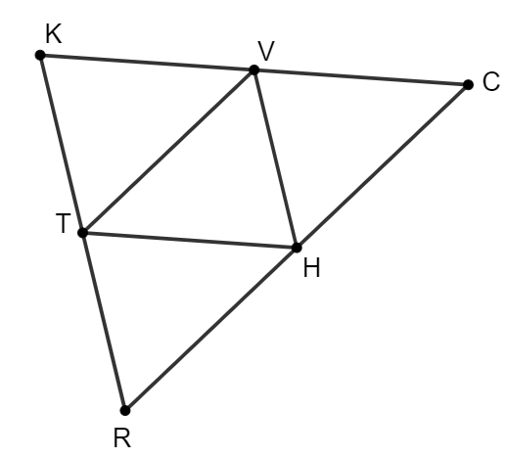
11.8.4 Your Turn!
$∆KCR$ is shown, where $T$, $V$, and $H$ are midpoints. $KC=(5x)$, $VH=\left(\frac{1}{3}y+11\right)$, $VT=(6w−5)$, $KR=(2y−2)$, $RC=(8w+8)$, and $TH=(3x−4)$.
volume 2, pg. 224

Slide 21
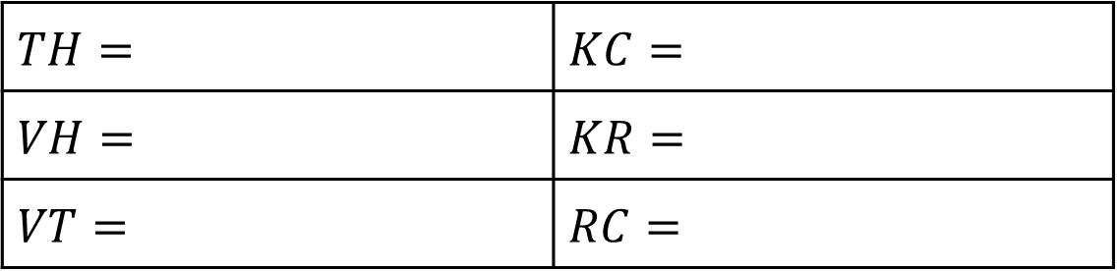
Find the value of each variable.
Complete the table.
$$x=$$ | $$y=$$ | $$w=$$
$$TH=$$ | $$KC=$$
$$VH=$$ | $$KR=$$
$$VT=$$ | $$RC=$$
volume 2, pg. 224

Slide 22

Wrap-Up
volume 2, pg. 224

Slide 23
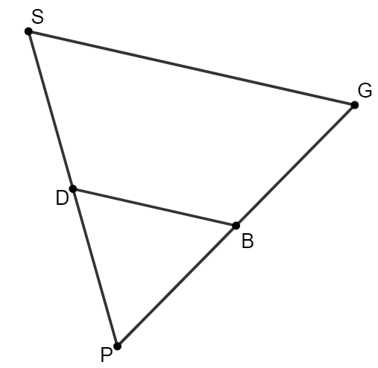
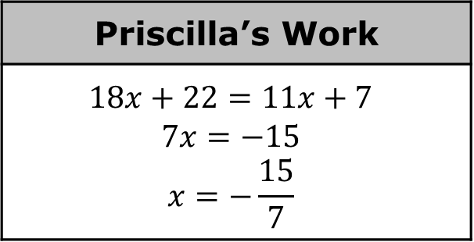
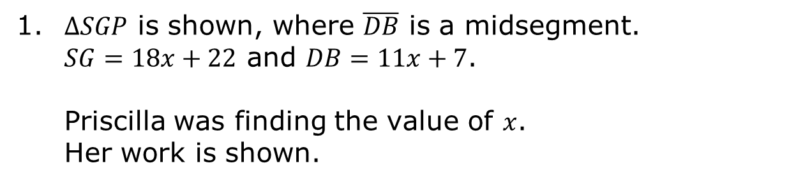
11.8.5 Wrap-Up: Error Analysis
1. $∆SGP$ is shown, where $\overline{DB}$ is a midsegment.
$SG=18x+22$ and $DB=11x+7$.
Priscilla was finding the value of $x$.
Her work is shown.
Priscilla’s Work
$$18x+22=11x+7$$ $$7x=−15$$ $$x=−\frac{15}{7}$$
volume 2, pg. 224

Slide 24

Write a note to Priscilla explaining her mistake.
Find the value of $x$.
volume 2, pg. 224

